Slide 1
Database Applications and Information Systems
Topic: Relational Algebra
Dr. Dan Lin

Slide 2
Announcement
Quiz 2 will be on Sep 21.
  Cover the relational model and relational algebra that we learned so far
  Closed book: no books/notes/laptop
  25 minutes

Slide 3
What is an “Algebra”?
Mathematical system consisting of:
  Operands : variables or values from which new values can be constructed.
  Operators : symbols denoting procedures that construct new values from given values.

Slide 4
What is Relational Algebra?
The relational model is an abstract (mathematical) modeling of a table
  Relational algebra (RA): an algebra whose operands are relations or variables that represent relations.
  A (mathematical) query language for relations
  Query language = languages for writing questions about the data

Slide 5
Why do we need to understand RA?
Real queries are written in SQL, but are translated by the query processor into relational algebra
Why?
  SQL is declarative, RA provides operations for execution
  Optimization is easier in RA, since we can take advantage of (provable) expression equivalences

Slide 6
What you should know from this course
How to write queries in relational algebra
How to calculate the result of a relational algebra expression over a set of relations
How to determine whether two relational algebra expressions are equivalent

Slide 7
Relational Algebra
Relational algebra has a collection of operators on relations
Operators may be unary or binary
The output of an operator is a relation
  Another way to say this is that the algebra is “closed”
  Therefore, operators can be composed one on another

Slide 8
Basic Operators
Relational Algebra has 5 basic operators:
  Project (π)
  Select (σ)
  Union (U)
  Set difference (-)
  Cartesian product (X)
Other operators can be defined using the basic ones: Intersection, Join, Division …
A useful syntactic operator: Rename

Slide 9
Example Relations
R
tid | sid | course
20 | 202 | os
10 | 450 | calculus
20 | 202 | db
20 | 240 | db
S
sid | sname | year
240 | white | 3
202 | jones | 3
450 | adams | 1
T
tid | tname | dept
10 | cohen | math
20 | levy | cs
S = Students
T = Teachers
R = Studies

Slide 10
The Project Operation
The Project operation is unary (i.e., it is applied to a single relation)
Denoted as: Π_{A1,…,An} (R)
  A₁,…,A_{n} are attributes
Projection returns a new relation that contains only the columns A₁,…,A_{n} from the original relation
Output relation does not have a name

Slide 11
Example: Find the teacher’s ID (tid) for each course
R
Π_{tid,course} R
tid | sid | course
20 | 202 | os
10 | 450 | calculus
20 | 202 | db
20 | 240 | db
tid | course
20 | os
10 | calculus
20 | db
Less tuples in result. Why?

Slide 12
The Project Operation
Duplicate elimination
  The Project operation removes any duplicate tuples, so the output is a valid relation
When computing a projection on a relation with n tuples,
  What is the minimum number of tuples in the result?
  What is the maximum number of tuples in the result?

Slide 13
The Project Operation
Π_{list1} (Π_{list2} R) = Π_{list1} R
Note: list2 must contain attributes in list1; Otherwise, the left-hand side is incorrect.

Slide 14
The Select Operation
Unary operator
Written as σ_{C}(R)
  C is a Boolean condition over each single tuple in R
Returns the tuples that satisfy C

Slide 15
Example
Return the courses taught by teacher number 20
R
σ_{tid} ₌ ₂₀ R
tid | sid | course
20 | 202 | os
10 | 450 | calculus
20 | 202 | db
20 | 240 | db
tid | sid | course
20 | 202 | os
20 | 202 | db
20 | 240 | db

Slide 16
What types of Conditions can be used?
The condition is made up of comparisons that are connected using logical operators (and, or)
Comparisons are between 2 attributes or between an attribute and a constant
  attribute1 op attribute2 (e.g. balance<credit_limit)
  attribute1 op constant (e.g. tid=20)
Important! Conditions are evaluated a single tuple at a time.

Slide 17

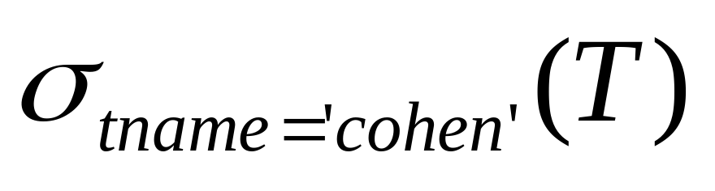
Types of Comparisons
We can use any of the operators:
When comparing an attribute with a string, the string is written in single quotes

Slide 18
The Select Operation
Examples
  σ_{tid} _{= 20 and course = `os’} R
  σ_{tid} _{= 10 and course = `db’} R
  σ_{tid} _{= 20 or sid=202 or sid=450} R
  What are the results
  of the above queries?
R
tid | sid | course
20 | 202 | os
10 | 450 | calculus
20 | 202 | db
20 | 240 | db

Slide 19
The Select Operaiton
σ_{c1} (σ_{c2} (R)) = σ_{c2} (σ_{c1} (R)) = σ_{c1 and c2} (R)
When computing a selection on a relation with n tuples,
  What is the minimum number of tuples in the result?
  What is the maximum number of tuples in the result?

Slide 20
Combining Selection and Projection
What does this compute?
Π_{course}(σ_{tid} ₌ ₂₀ R)
tid | sid | course
20 | 202 | os
10 | 450 | calculus
20 | 202 | db
20 | 240 | db
Can we change the order of these two operations?

Slide 21
Example
How would you find the names of the third year students?
?
S
sid | sname | year
240 | white | 3
202 | jones | 3
450 | adams | 1
sname
white
Jones

Slide 22
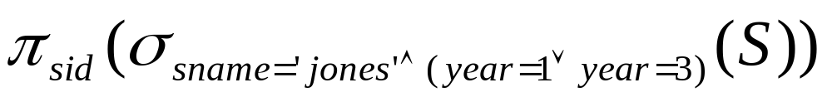
Example
Find id of students named jones who are in their first year or third year of studies
S
sid | sname | year
240 | white | 3
202 | jones | 3
450 | adams | 1
sid
202

Slide 23
Once Again
What is in the result of the query when we have this instance of S?
S
sid | sname | year
240 | white | 3
202 | jones | 3
450 | jones | 1
sid
202
450

Slide 24
Brief Review
Basic relational algebra operations
  Selection (σ): Selects a subset of rows from relation.
  Projection (π) : Deletes unwanted columns from relation.

Slide 25
Question
R
tid | sid | course
20 | 202 | os
10 | 450 | calculus
20 | 202 | db
20 | 240 | db
Who is teaching ‘db’ course?

Slide 26
Example
Find id of students named jones who are in their first year or third year of studies
S
sid | sname | year
240 | white | 3
202 | jones | 3
450 | adams | 1
sid
202

Slide 27
Example
Find id of students named jones who are in their first year or third year of studies
S
sid | sname | year
240 | white | 3
202 | jones | 3
450 | adams | 1
sid
202

Slide 28
Once Again
What is in the result of the query when we have this instance of S?
S
sid | sname | year
240 | white | 3
202 | jones | 3
450 | jones | 1

Slide 29
Once Again
What is in the result of the query when we have this instance of S?
S
sid | sname | year
240 | white | 3
202 | jones | 3
450 | jones | 1
sid
202
450

Slide 30

Question
What is the result (and meaning) of this query?
S
sid | sname | year
240 | white | 3
202 | jones | 3
450 | jones | 1
Nothing in the result

Slide 31
Question
What is the result (and meaning) of this query?
S
sid | sname | year
240 | white | 3
202 | jones | 3
450 | jones | 1

Slide 32
Union

Slide 33
The Union Operation
Binary operator; Written as R ∪ S
Union can only be performed between compatible relations
  same number of attributes
  corresponding attributes have the same type
Result contains all tuples in at least one of the relations
The attribute names from R are used as the schema of the result

Slide 34


Example
S ∪ G
sid | sname | year
240 | white | 3
202 | jones | 3
450 | adams | 1
sid | sname | year
701 | katz | 1
202 | jones | 3
820 | sapir | 2

Slide 35
Example
S ∪ G
sid | sname | year
240 | white | 3
202 | jones | 3
450 | adams | 1
sid | sname | year
240 | white | 3
202 | jones | 3
701 | katz | 1
820 | sapir | 2
450 | adams | 1
sid | sname | year
701 | katz | 1
202 | jones | 3
820 | sapir | 2

Slide 36
Example
sid | sname | year
240 | white | 3
202 | jones | 3
S ∪ G
?
ID | Name | year
202 | jones | 3

Slide 37
Example
sid | sname | year
240 | white | 3
202 | jones | 3
S ∪ G
?
sid | sname | year
240 | white | 3
202 | jones | 3
ID | Name | year
202 | jones | 3

Slide 38
Exercise
CS_Course(sid, course, semester)
Math_Course(sid, course, semester,grade)
Write a query to find the students who took a ‘db’ course in CS department or a ‘statis’ course in Math department

Slide 39
Think about it
Suppose that R has n tuples, and S has m tuples
  What is the minimum number of tuples in R∪S ?
  What is the maximum number of tuples in R∪S ?
Must duplicates be eliminated when processing a union?

Slide 40
Set Difference

Slide 41
The Set Difference Operation
Binary operator; written as R - S
Can only be performed between relations that are compatible
Result contains the tuples from R, but not in S
Schema attributes of result are those of R

Slide 42
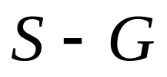
Example
sid | sname | year
240 | white | 3
202 | jones | 3
450 | adams | 1
ID | sname | year
701 | katz | 1
202 | jones | 3
820 | sapir | 2

Slide 43
Example
sid | sname | year
240 | white | 3
202 | jones | 3
450 | adams | 1
sid | sname | year
240 | white | 3
450 | adams | 1
ID | sname | year
701 | katz | 1
202 | jones | 3
820 | sapir | 2
What about G-S?

Slide 44
Find ID’s of students who DO NOT study ‘db’
R
tid | sid | course
20 | 202 | os
10 | 450 | calculus
20 | 202 | db
20 | 240 | db

Slide 45
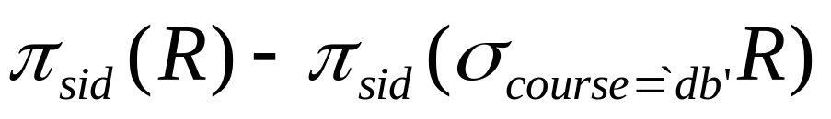
Find ID’s of students who DO NOT study ‘db’
R
tid | sid | course
20 | 202 | os
10 | 450 | calculus
20 | 202 | db
20 | 240 | db

Slide 46
Think about it
Suppose that R has n tuples, and S has m tuples
  What is the minimum number of tuples in R-S ?
  What is the maximum number of tuples in R-S ?
Must duplicates be eliminated when processing a union?

Slide 47
How to find the course taught by Levy?
R
T
tid | sid | course
20 | 202 | os
10 | 450 | calculus
20 | 202 | db
20 | 240 | db
tid | tname | dept
10 | Cohen | math
20 | Levy | cs
R = Studies
T = Teachers

Slide 48
Cartesian Product

Slide 49
Cartesian Product
(Cross Product)
Binary Operator; Written as R×S
R and S do not need to be compatible
Cartesian product produces a new relation by combining every tuple from one relation with every tuple from the other relation.
Column names that appear in both R and S are undefined in output
Number of tuples in the results is always the product of the number of tuples in R and in S

Slide 50

)tid( | sid | course | )tid( | tname | dept
20 | 202 | os | 10 | cohen | math
10 | 450 | calculus | 10 | cohen | math
20 | 202 | db | 10 | cohen | math
20 | 240 | db | 10 | cohen | math
20 | 202 | os | 20 | levy | cs
10 | 450 | calculus | 20 | levy | cs
20 | 202 | db | 20 | levy | cs
20 | 240 | db | 20 | levy | cs

Slide 51
When to Use Cartesian Product
In order to get a meaningful result, we usually write queries that have both a Cartesian product and a selection.
  More about this soon, when we discuss join operator
What happens when a Cartesian product is applied and one of the relations is empty?

Slide 52
Rename

Slide 53
The Rename Operation
Field conflicts may sometimes occur in a relational algebra expression (e.g., when using Cartesian product)
Renaming can also give a sub-expression a name, which can be used to break down long expressions

Slide 54
The Rename Operation
Written as ρ; has following forms:
  ρ_{S (B1, B2, …, Bn )}(R) changes both:
    the relation name to S, and
    the column (attribute) names to B1, B1, …..Bn
  ρ_{S}(R) changes:
    the relation name only to S
  ρ_{(B1, B2, …, Bn )}(R) changes:
    the column (attribute) names only to B1, B1, …..Bn

Slide 55
Both columns have the same name,
result is undefined
)tid( | sid | course | )tid( | tname | dept
20 | 202 | os | 10 | cohen | math
10 | 450 | calculus | 10 | cohen | math
20 | 202 | db | 10 | cohen | math
20 | 240 | db | 10 | cohen | math
20 | 202 | os | 20 | levy | cs
10 | 450 | calculus | 20 | levy | cs
20 | 202 | db | 20 | levy | cs
20 | 240 | db | 20 | levy | cs

Slide 56
ρCourse (tid1,sid,course,tid2,tname,dpmnt)(RXT)
Course
tid1 | sid | course | tid2 | tname | dpmnt
20 | 202 | os | 10 | cohen | math
10 | 450 | calculus | 10 | cohen | math
20 | 202 | db | 10 | cohen | math
20 | 240 | db | 10 | cohen | math
20 | 202 | os | 20 | levy | cs
10 | 450 | calculus | 20 | levy | cs
20 | 202 | db | 20 | levy | cs
20 | 240 | db | 20 | levy | cs

Slide 57
σ_{tid1=tid2} (ρCourse (tid1,sid,course,tid2,tname,dpmnt)(RXT))
Course
tid1 | sid | course | tid2 | tname | dept
20 | 202 | os | 10 | cohen | math
10 | 450 | calculus | 10 | cohen | math
20 | 202 | db | 10 | cohen | math
20 | 240 | db | 10 | cohen | math
20 | 202 | os | 20 | levy | cs
10 | 450 | calculus | 20 | levy | cs
20 | 202 | db | 20 | levy | cs
20 | 240 | db | 20 | levy | cs

Slide 58
Question
R
Find the names of the courses taught by Levy
tid | sid | course
20 | 202 | os
10 | 450 | calculus
20 | 202 | db
20 | 240 | db
T
tid | tname | dept
10 | cohen | math
20 | levy | cs

Slide 59
Sequence of Operations
We can explicitly show the sequence of operations, giving a name to each intermediate relation.
  Can also rename the attributes in the intermediate relation.
Example:
  Course(tid1,sid,course,tid2,tname,dpmnt) ← R X T
  Teach_Course ← σ_{tid1=tid2} (Course)

Slide 60
Brief Review
Relational Algebra
Basic operations
  Projection (π): extract columns
  Selection (σ): extract rows
  Union (U): union two compatible relations
  Set-difference or Minus (-): find difference
  Cross-product (X): connect two relations
Syntactic operation: renaming
Since each operation returns a relation, operations can be composed to get an expression!

Slide 61
Review
sid | sname | year
240 | white | 3
202 | jones | 3
S ∪ G
?
sid | Name | year | Age
202 | jones | 3 | 19

Slide 62
Review
sid | sname | year
240 | white | 3
202 | jones | 3
S ∪ G
?
Union cannot be applied in this case
sid | Name | year | Age
202 | jones | 3 | 19

Slide 63
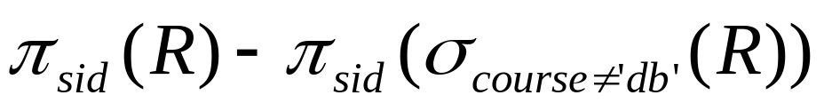
Review
R
tid | sid | course
20 | 202 | os
10 | 450 | calculus
20 | 245 | db
20 | 202 | db
What is the result?

Slide 64
Review
R
tid | sid | course
20 | 202 | os
10 | 450 | calculus
20 | 245 | db
20 | 202 | db
What is the result?
Students who take only “db” course
sid
245

Slide 65
Additional Operators

Slide 66
Additional Operators
We discussed the 5 basic operators of relational algebra
Additional operators can be defined in terms of the 5 basic operators
Defining additional operators is a good idea for two reasons:
  Allows us to write simpler expressions
  Allows individual optimization

Slide 67
Intersection

Slide 68
Intersection
Binary operator
Written as R∩S
Performed between compatible relations
Result contains the tuples that appear in R and S

Slide 69
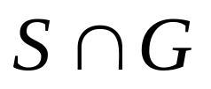
Example
sid | sname | year
240 | white | 3
202 | jones | 3
450 | adams | 1
What is in the result?
id | sname | year
701 | katz | 1
202 | jones | 3
820 | sapir | 2

Slide 70
Example
sid | sname | year
240 | white | 3
202 | jones | 3
450 | adams | 1
What is in the result?
id | sname | year
701 | katz | 1
202 | jones | 3
820 | sapir | 2
sid | sname | year
202 | jones | 3

Slide 71
Think about it
Suppose that R has n tuples and S has m tuples
  What is the minimum number of tuples in R∩S?
  What is the maximum number of tuples in R∩S?
How can we define ∩ using the other operators?

Slide 72
Join

Slide 73
The Join Operation
The result of a Cartesian product is not usually very meaningful.
In order to derive an interesting result, selection is usually composed into the Cartesian product as shown in the following example.

Slide 74
Find the courses taught by Levy
R
T
tid1 | sid | course
20 | 202 | os
10 | 450 | calculus
20 | 202 | db
20 | 240 | db
tid2 | tname | dept
10 | Cohen | math
20 | Levy | cs

Slide 75
π _{course} (σ_{tid1=tid2 and tname=`levy’} (RXT))
tid1 | sid | course | tid2 | tname | dept
20 | 202 | os | 10 | cohen | math
10 | 450 | calculus | 10 | cohen | math
20 | 202 | db | 10 | cohen | math
20 | 240 | db | 10 | cohen | math
20 | 202 | os | 20 | levy | cs
10 | 450 | calculus | 20 | levy | cs
20 | 202 | db | 20 | levy | cs
20 | 240 | db | 20 | levy | cs

Slide 76
The Join Operation
Join is a “shortcut” for writing the combination of selection and cross product.
We will see three types of joins:
  Conditional join
  Equijoin
  Natural join

Slide 77


Conditional Join
A conditional join has the format
where C is a condition, as in a Select
This expression is equivalent to:

Slide 78
R
_{tid1<tid2} S
Which rows are in the result?
tid1 | sid | course | tid2 | tname | dept
20 | 202 | os | 10 | cohen | math
10 | 450 | calculus | 10 | cohen | math
20 | 202 | db | 10 | cohen | math
20 | 240 | db | 10 | cohen | math
20 | 202 | os | 20 | levy | cs
10 | 450 | calculus | 20 | levy | cs
20 | 202 | db | 20 | levy | cs
20 | 240 | db | 20 | levy | cs

Slide 79
R
_{tid1<tid2} S
tid1 | sid | course | tid2 | tname | dept
10 | 450 | calculus | 20 | levy | cs

Slide 80
Find the students who are taught by teachers from CS department
R
T
tid1 | sid | course
20 | 202 | os
10 | 450 | calculus
20 | 202 | db
20 | 240 | db
tid2 | tname | dept
10 | Cohen | math
20 | Levy | cs

Slide 81
Find the students who are taught by teachers from CS department
R
T
tid1 | sid | course
20 | 202 | os
10 | 450 | calculus
20 | 202 | db
20 | 240 | db
tid2 | tname | dept
10 | Cohen | math
20 | Levy | cs
Πsid
(R
_{tid1=tid2 and dept=‘cs’} S)

Slide 82
Exercise
R1
Find the id of an employee whose salary is twice of another employee’s.
id | Salary
1 | 100K
2 | 80K
3 | 50K
4 | 40K

Slide 83
Exercise
R1
Find the id of an employee whose salary is twice of another employee’s.
id | Salary
1 | 100K
2 | 80K
3 | 50K
4 | 40K
Hint: R1 conditional join with R1

Slide 84
Equijoin
This is a special conditional join, where all the conditions require equalities between attributes.
For such cases, the output relation will contain one or more pairs of attributes with identical values for every tuple.

Slide 85
R
_{tid1=tid2} S
What is in the result?
tid1 | sid | course | tid2 | tname | dept
20 | 202 | os | 10 | cohen | math
10 | 450 | calculus | 10 | cohen | math
20 | 202 | db | 10 | cohen | math
20 | 240 | db | 10 | cohen | math
20 | 202 | os | 20 | levy | cs
10 | 450 | calculus | 20 | levy | cs
20 | 202 | db | 20 | levy | cs
20 | 240 | db | 20 | levy | cs

Slide 86
R
_{tid1=tid2} S
tid1 | sid | course | tid2 | tname | dept
20 | 202 | os | 10 | cohen | math
10 | 450 | calculus | 10 | cohen | math
20 | 202 | db | 10 | cohen | math
20 | 240 | db | 10 | cohen | math
20 | 202 | os | 20 | levy | cs
10 | 450 | calculus | 20 | levy | cs
20 | 202 | db | 20 | levy | cs
20 | 240 | db | 20 | levy | cs

Slide 87

Natural Join
This is a special equijoin, where we require equalities between all fields that have the same names in the two relations
For the same attributes, only keep one column in the output relation.
It has no condition, so it is written as
R * S or
Translating a Natural Join to an operation using only the basic operators requires Cartesian product, selection and projection.

Slide 88
Example Relations
R
tid | sid | course
20 | 202 | os
10 | 450 | calculus
20 | 202 | db
20 | 240 | db
R * T = ?
T
tid | tname | dept
10 | cohen | math
20 | levy | cs

Slide 89
Example Relations
R
tid | sid | course
20 | 202 | os
10 | 450 | calculus
20 | 202 | db
20 | 240 | db
R * T = ?
tid | sid | course | tname | dept
10 | 450 | calculus | cohen | math
20 | 202 | os | levy | cs
20 | 202 | db | levy | cs
20 | 240 | db | levy | cs
T
tid | tname | dept
10 | cohen | math
20 | levy | cs
Π_{tid,sid,course,tname,dept}
(R
_{R.tid=T.tid} T)

Slide 90
Natural Join
Question: What is in R*S if R and S have no common attributes?
Question: What is in R*S if R and S all the same attributes?

Slide 91
Example Relations
R
tid | sid | course
20 | 202 | os
10 | 450 | calculus
20 | 202 | db
20 | 240 | db
R * T = ?
T
ID | tname | dept
10 | cohen | math
20 | levy | cs

Slide 92
Example Relations
R1
tid | sid | course
20 | 202 | os
10 | 450 | calculus
20 | 202 | db
20 | 240 | db
R1 * R2 = ?
R2
tid | sid | course
10 | 450 | calculus
20 | 330 | network

Slide 93
Example Relations
R1
tid | sid | course
20 | 202 | os
10 | 450 | calculus
20 | 202 | db
20 | 240 | db
R1 * R2 = ?
tid | sid | course
10 | 450 | calculus
R2
tid | sid | course
10 | 450 | calculus
20 | 330 | network

Slide 94
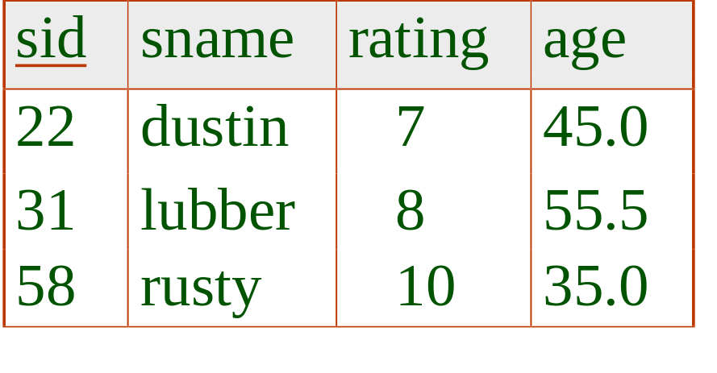
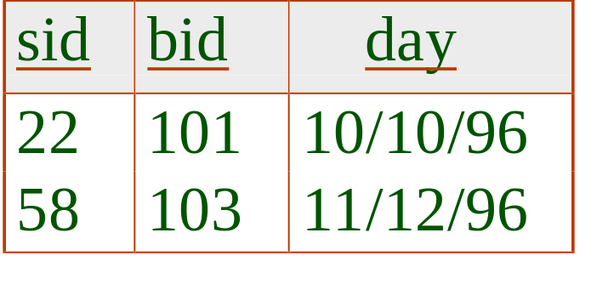
Question (Level 1)
Find the names of the sailors who reserved a boat.
Π_{sname} ( Reserve * Sailor)
Sailor
Reserve

Slide 95
Question (Level 2)
Find the names of the sailors
who reserved Boat `Dream’.
Reserve
Boat
Sailor
sid | bid | day
58 | 102 | 1/1/99
22 | 101 | 10/10/96
58 | 101 | 8/8/96
58 | 103 | 11/11/96
bid | name | year
101 | Victory | 1
102 | Wind | 3
103 | Dream | 1
sid | sname | age
22 | Dustin | 45
31 | Rubber | 55
58 | Rusty | 35

Slide 96
Question (Challenging)
Find the id of the sailors who reserved ALL boats.
Reserve
Boat
sid | bid | day
58 | 102 | 1/1/99
22 | 101 | 10/10/96
58 | 101 | 8/8/96
58 | 103 | 11/11/96
bid | name | year
101 | Victory | 1
102 | Wind | 3
103 | Dream | 1

Slide 97
Question (Challenging)
Find the id of the sailors who reserved ALL boats.
Reserve (sid, bid, day) Boat (bid, name, year)
Step 1: create a table where everyone reserves all boats.
Step 2: find sailors who didn’t reserve all boats
Step 3: find sailors who reserve all boats

Slide 98
Question (Challenging)
Find the id of the sailors who reserved ALL boats.
Reserve (sid, bid, day) Boat (bid, name, year)
Step 1: create a table where everyone reserves all boats.
R1 ← (π_{sid} Reserve) X π _{bid} Boat)
Step 2: find sailors who didn’t reserve all boats
Step 3: find sailors who reserve all boats

Slide 99
Question (Challenging)
Find the id of the sailors who reserved ALL boats.
Reserve (sid, bid, day) Boat (bid, name, year)
Step 1: create a table where everyone reserves all boats.
R1 ← (π_{sid} Reserve) X π _{bid} Boat)
Step 2: find sailors who didn’t reserve all boats
R2 ← R1 – π_{sid, bid} Reserve
Step 3: find sailors who reserve all boats

Slide 100
Question (Challenging)
Find the id of the sailors who reserved ALL boats.
Reserve (sid, bid, day) Boat (bid, name, year)
Step 1: create a table where everyone reserves all boats.
R1 ← (π_{sid} Reserve) X π _{bid} Boat)
Step 2: find sailors who didn’t reserve all boats
R2 ← R1 – π_{sid, bid} Reserve
Step 3: find sailors who reserve all boats
R3 ← π _{sid} Reserve – π_{sid} R2

Slide 101
Division

Slide 102
Reconsider the Question
Find the id of the sailors who reserved ALL boats.
Reserve (sid, bid, day)
Boat (bid, name, year)
(π_{sid,bid} Reserve) ÷ (π_{bid} Boat)

Slide 103
Division
Division is useful to express “for all” queries
Examples:
  Find students who studied ALL of Dr Cohen’s courses
  Find lecturers who have taught ALL of the students
We will use ÷ to denote division.

Slide 104
Division
Can perform R ÷ S if all the attributes appearing in S also appear in R
The result is a relation with all attributes appearing in R but not in S
R(X₁,…,X_{k},Y₁,…,Y_{m}), S(Y₁,…,Y_{m}):
  R ÷ S : What attributes are in the result?

Slide 105
Division
Consider:
  A(X₁,…,X_{k},Y₁,…,Y_{m})
  B(Y₁,…,Y_{m})
Then A÷B =

Slide 106
Find suppliers (sno) from A who supply All parts (pno) from B
A
sno | pno
S1 S1 S1 S1 S2 S2 S3 S4 S4 | P1 P2 P3 P4 P1 P2 P2 P2 P4
B
÷
pno
sno
=
P2

Slide 107
Find suppliers (sno) from A who supply All parts (pno) from B
A
sno | pno
S1 S1 S1 S1 S2 S2 S3 S4 S4 | P1 P2 P3 P4 P1 P2 P2 P2 P4
B
÷
pno
sno
=
P2
S1
S2
S3
S4

Slide 108
Find suppliers (sno) from A who supply All parts (pno) from B
A
sno | pno
S1 S1 S1 S1 S2 S2 S3 S4 S4 | P1 P2 P3 P4 P1 P2 P2 P2 P4
B
pno
sno
÷
=
P2
P4

Slide 109
Find suppliers (sno) from A who supply All parts (pno) from B
A
sno | pno
S1 S1 S1 S1 S2 S2 S3 S4 S4 | P1 P2 P3 P4 P1 P2 P2 P2 P4
B
pno
sno
÷
=
P2
P4
S1
S4

Slide 110
Find suppliers (sno) from A who supply All parts (pno) from B
A
sno | pno
S1 S1 S1 S1 S2 S2 S3 S4 S4 | P1 P2 P3 P4 P1 P2 P2 P2 P4
B
÷
pno
=
sno
P1
P2
P4

Slide 111
Find suppliers (sno) from A who supply All parts (pno) from B
A
sno | pno
S1 S1 S1 S1 S2 S2 S3 S4 S4 | P1 P2 P3 P4 P1 P2 P2 P2 P4
B
÷
pno
=
sno
P1
P2
P4
S1

Slide 112
Translating to Basic Operators
To find the suppliers who supply all the parts
(A) ÷(B)
Division can be expressed using other relational algebra operators. How?
π_{x1,…,xk} A – π_{x1,..,xk}((π_{x1,…,xk} A x B) – A)

Slide 113
Example for Division
Consider the following two relaitons. Find the teachers who taught ALL the students.
Teacher(tid, sid, course)
Student(sid,name, year)

Slide 114
Aggregate Function and Grouping

Slide 115
Example
What is the total number of students enrolled in CS2300 each year?
What is the average score for quiz 2?

Slide 116
Aggregate Function and Grouping
Specify mathematical aggregate functions on collections of values from the database.
Common functions
  SUM
  AVERAGE
  MAXIMUM and MINIMUM
  COUNT (for counting tuples)
Tuples can be grouped before applying the aggregation functions.

Slide 117
Aggregate Function and Grouping
Written as _{grouping_attributes}ℱ_{F1,F2,…Fn}(R)
Group tuples having the same values for the grouping attributes (can be multiple attributes).
Each function is in the form:
  <function> <attribute>
  Example: Max salary; Count ssn
Attributes in the result include grouping attributes and all aggregation functions.

Slide 118
Aggregate Function and Grouping
Report the total number of students for each year
_{year}ℱ_{Count sid} (R)
S
sid | sname | year
240 | white | 3
202 | jones | 3
450 | adams | 1
year | Count_sid
3 | 2
1 | 1

Slide 119
R
Report the number of courses taught by Dr. levy.
tid | sid | course
20 | 202 | os
10 | 450 | calculus
20 | 202 | db
20 | 240 | db
ℱ_{Count course} (π_{course}(R*(σ_{tname=`levy’}T))
T
tid | tname | dept
10 | cohen | math
20 | levy | cs

Slide 120
R
Report the number of courses taught by Dr. levy.
tid | sid | course
20 | 202 | os
10 | 450 | calculus
20 | 202 | db
20 | 240 | db
ℱ_{Count course} (π_{course}(R*(σ_{tname=`levy’}T))
Count_course
2
T
tid | tname | dept
10 | cohen | math
20 | levy | cs

Slide 121
More Examples
EMPLOYEE (SSN, Name, Salary, Year)
ℱ_{MAX Salary} (EMPLOYEE)
  retrieves the maximum salary value from the EMPLOYEE relation
_{Year}ℱ_{MIN Salary, AVG Salary} (EMPLOYEE)
  retrieves the minimum and average Salary values from the EMPLOYEE relation for each year.
ℱ_{SUM Salary} (EMPLOYEE)
  retrieves the sum of the Salary from the EMPLOYEE relation

Slide 122
Generalized Projection

Slide 123
Generalized Projection
Consider the following relation and report the net salary of an employee
Employee(ssn, salary, tax, year)
Net salary = salary – tax
π_{salary-tax}Employee

Slide 124
Generalized Projection
The generalized projection extends the projection by allowing functions of attributes to be included in the projection list.
π_{F1,F2,…,Fn} (R)
F1,F2,…Fn are functions over the attributes in R and may involve constants.
This is needed when developing reports where computed values have to be produced

Slide 125
Expressions in a Single Assignment
Precedence of relational operators:
    Unary operators have highest precedence, bind first.
    Then come products and joins.
    Then intersection.
    Finally, union and set difference bind last.
But you can always insert parentheses to force the order you desire.

Slide 126
Equivalence Among
Relational Algebra Expressions

Slide 127
What Does Equivalence Mean?
We say that expressions E1 and E2 are equivalent if, regardless of the tuples in the relations mentioned in E1 and E2, these expressions always return the same answers
Simple example: Consider the relation R(A,B,C). The following three expressions are equivalent
  π_{A} R π_{A} π_{A,B} R π_{A} π_{A,C} R

Slide 128
Why?
Why do we care that the expressions are equivalent?
Mostly, for optimizations. Which expression is the most efficient?

Slide 129
Question
Suppose that we have R(A,B) and S(A,B)
Is π_{A} R ∪ π_{A} S equivalent to π_{A} (R ∪ S) ?
Is π_{A} R - π_{A} S equivalent to π_{A} (R - S) ?

Slide 130
What’s Next
Relational Model Mapping…

